Slide 1

PREDICTING RESTAURANT TIPS EXCEL assessment

Slide 2
Project Workbook

Slide 3
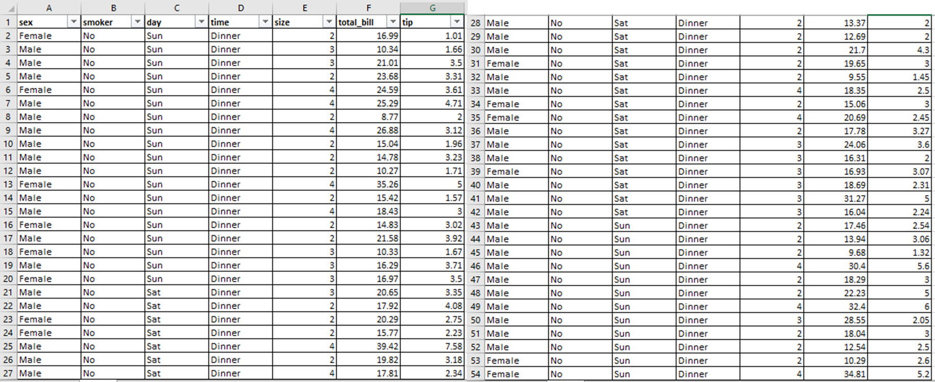
DATASET
Note: Please Double click
the table to view the dataset

Slide 4
ENCODED DATA
Note: Please Double click
the table to view the dataset

Slide 5
CORRELATION MATRIX
Note: Please Double click
the table to view the worksheet

Slide 6
LINEAR REGRESSION
Note: Please Double click
the table to view the dataset

